Slide 1

Data Science
Final Project Presentation
Michael Yung

Slide 2
Minor Details …
Hypothesis
Finding the “Right People”, in professional network
Data
LinkedIn social network – Connections, and Skills
Techniques
API, Scraping, {Bag of Words}, Euclidean Distance, KMeans Clustering and Lots of Coffee
Visualizations & Findings
ManyEyes.com and whatever output from the Python programs …

Slide 3
Hypothesis
  It’s easy to connect to any people in Social Networks
  In Linkedin, you connect with like-minded professionals in your industry
  Nowadays, Linkedin is a very good recruitment tool
    You can search, filter, contact the candidates
    You can also check their job history, skills and expert areas
    Both skills and experts areas are “endorsed” by their connections, but not entered by themselves
  Ideas – If I want to hire someone …
    Use the candidate’s endorsed skills to match one of my Linkedin connections
    → It will tell whether his / her profile is similar to my connections
    Match the candidate’s skills with skill groups (clusters)
    → That will help to plan for training and career development

Slide 4
Data
  Linkedin data is used
  It’s API accessible, except some information such as Skills (Ooops !!)
  “Skill” keywords are pretty much free from Less-important, Stemming and Stop words
  5xx Connections
  36xx Skills
  4xx unique Skills
Me

Slide 5
Techniques
  Python
    Linkedin API to get the connection URLs
    BeautifulSoup Python library to scrape the Skills from my connections, based on the connection URLs
    Get the closest connection – Euclidean norm (Shortest Distance)
    Get the closest cluster – KMeans
  ManyEyes.com
    Word Cloud
    Phrase Net
    Word Tree

Slide 6
Techniques – 4 Python Programs
Program 1
  Connect to Linkedin with credential
  Get own profile with API
  Get URLs of my connections with API
  Save URLs to a file for Program 2
Program 2
  Open the URLs file
  For each URL
    Use BeautifulSoup to scrap item “endorse-item-name-text”
    Save the skills for each connection to output file for Program 3 and 4

Slide 7
Techniques – 4 Python Programs …
Program 3
  Open skill file
  Create bag-of-word vector
  Input test skill and vectorize
  Calculate Euclidean Norm Distances
  Find the closest connection
  Find the farthest connection
Program 4
  Open skill file
  Vectorize, create 10 clusters using KMeans
  Input test skill and vectorize
  Predict which cluster it belongs
  Calculate similarities of other skills in the same cluster

Slide 8
Challenges
  Linkedin APIs let you retrieve your own skills, and your connections’ URLs but not your connections’ skills – that’s why I needed to use scraping …
  Linkedin block scraping tools like Kimono, Scrape – that’s why I used BeautifulSoup
  Scraping performance is rather poor
  KMeans generate random results since the initialization method is random
  ManyEyes.com has SSL certificate problem, requires Java and requires the PC to relax security

Slide 9
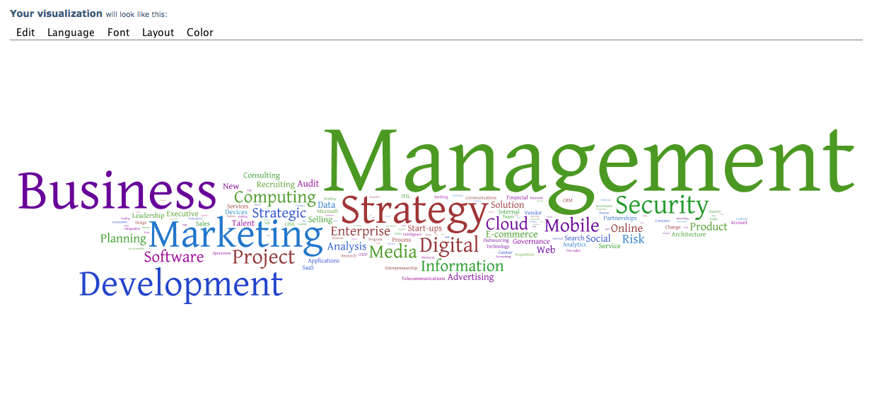
Visualizations – Word Cloud

Slide 10
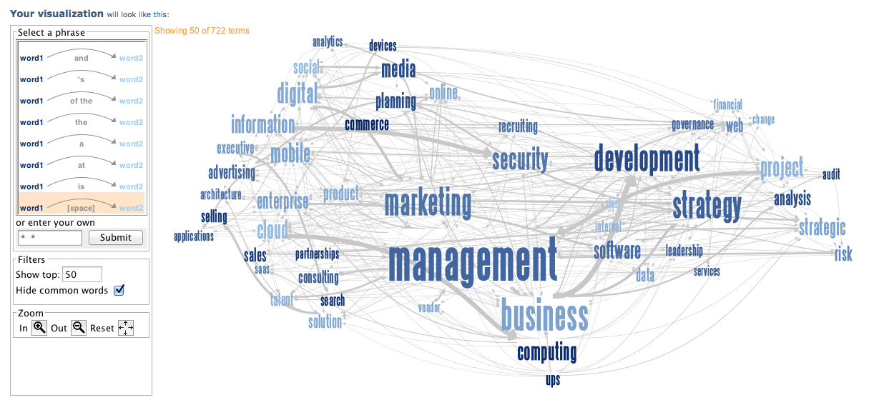
Visualizations – Phrase Net

Slide 11
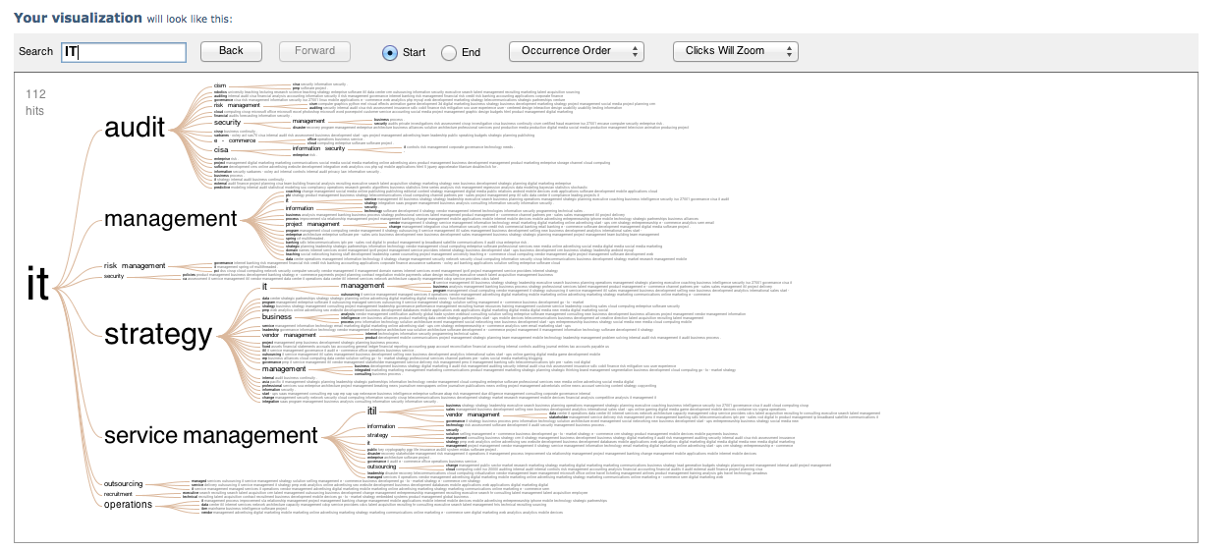
Visualizations – Word Tree

Slide 12
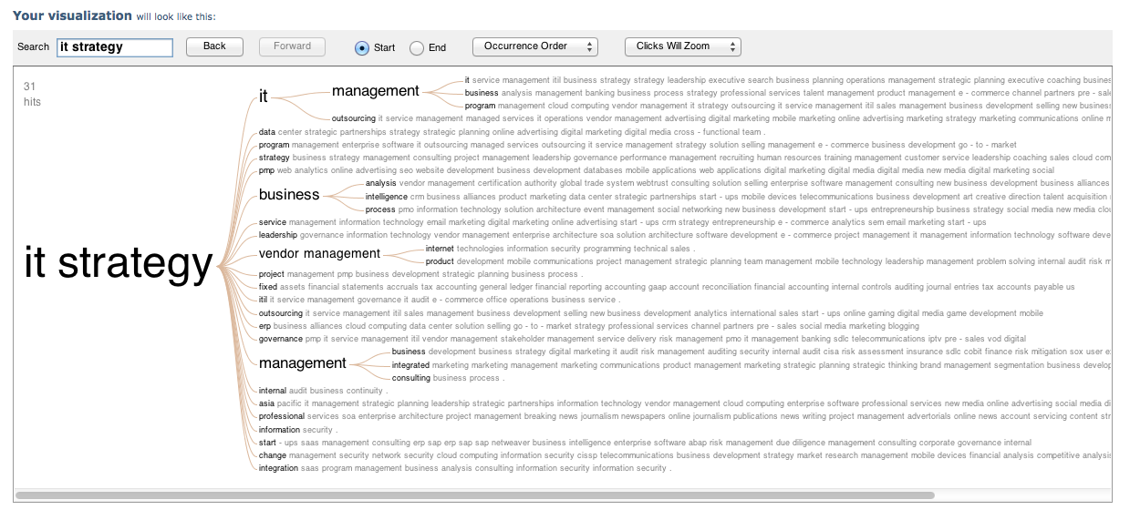
Visualizations – Word Tree (Drill down)

Slide 13
Similarity Measurement by Euclidean Distance - Closest
Input Skill | IT Strategy Information Technology Cloud Computing IT Management Project Management Security IT Audit PKI Databases Internet Technologies
Connection # with closest skill | 69
With Euclidean Distance : | 0.810780965067
Connection's corresponding URL : | http://www.linkedin.com/pub/andrew-cheng/34/887/848
Connection's domain knowledge : | Information Security Cloud Computing E-commerce Enterprise Software Product Management IT Management PKI Strategy

Slide 14
Similarity Measurement by Euclidean Distance - Farthest
Input Skill | IT Strategy Information Technology Cloud Computing IT Management Project Management Security IT Audit PKI Databases Internet Technologies
Connection # and farthest | 183
With Euclidean Distance : | 1.41421356237
Connection's corresponding URL : | http://www.linkedin.com/pub/bryan-hsiao/51/754/215
Connection's domain knowledge : | Strategic Planning Budgets PowerPoint Customer Service Microsoft Word English Research Outlook Public Speaking Negotiation Microsoft Office Microsoft Excel Windows Teaching

Slide 15
Findings – Clustering
Set to 10 clusters
KMeans and calculations converged at 7th iteration
Input skill and predict which cluster it belongs:
  Distance to Centroids :
    [[ 4.93378359] [ 3.91652908] [ 4.70560661] [ 6.32455532] [ 5.47062025]
    [ 7.07972097] [ 6.80991924] [ 7.51295178] [ 8.71779789] [ 5.31027114]]
  It’s therefore closest to 2nd cluster
  Found there are 25 skill sets in the same cluster
  Calculate how similar of other skill sets in the same cluster

Slide 16
Findings – Clustering
IT Strategy Information Technology Cloud Computing
IT Management Project Management Security
IT Audit PKI Databases Internet Technologies
Skills | Similarity | Cluster Text
1 | 3.7416 | Information Security Cloud Computing E-commerce Enterprise Software Product Management IT Management PKI Strategy
12 | 4.8989 | Solution Selling Cloud Computing Enterprise Software Product Management Account Management Information Security Project Management E-commerce
24 | 8.5440 | Testing Software Engineering PMP CMMI Software Project... Process Improvement Quality Assurance Software Quality... SDLC Project Management Linux Scrum Security Requirements Analysis Process Development Software Development... Agile Process Engineering Quality Management

Slide 17

Questions ?
mail@michaelyung.com

